Slide 1






Foundations of
Quantum Information Science (QIS 101)
Dave Biersach
Brookhaven National Laboratory
dbiersach@bnl.gov
Session 14a
Linear Algebra

Slide 2
Session 14a – Goals
Review real and complex vectors, including addition, scalar multiplication, and dot product
Review real and complex matrices, including matrix inversion, transpose, adjoint, and inner product
Identify and use diagonal, symmetric, Identity, Hermitian, and Unitary matrices
Understand basis sets, transition matrices, and the Hadamard matrix
Appreciate the eigenvectors and eigenvalues of a matrix

Slide 3
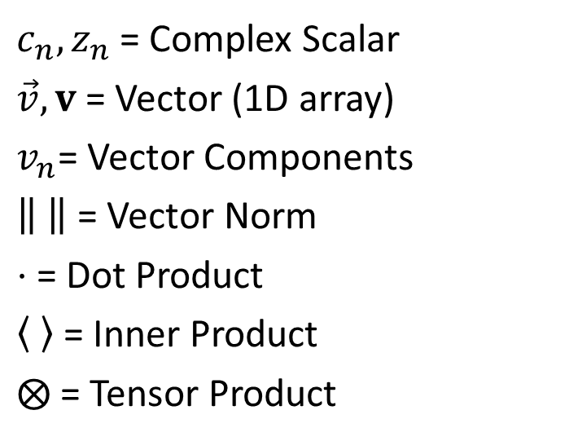
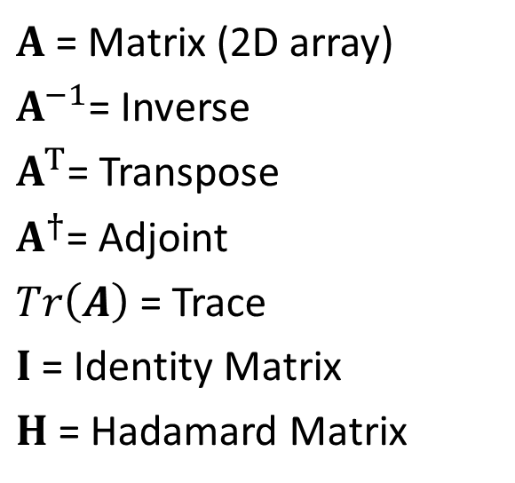
Symbols and Operators
$c_{n},z_{n}$ = Complex Scalar
$\vec{v}, v$ = Vector (1D array)
$v_{n}$= Vector Components
= Vector Norm
$⋅$ = Dot Product
= Inner Product
$⨂$ = Tensor Product
$A$ = Matrix (2D array)
$A^{−1}$= Inverse
$A^{T}$= Transpose
$A^{†}$= Adjoint
$Tr\left(A\right)$ = Trace
$I$ = Identity Matrix
$H$ = Hadamard Matrix

Slide 4
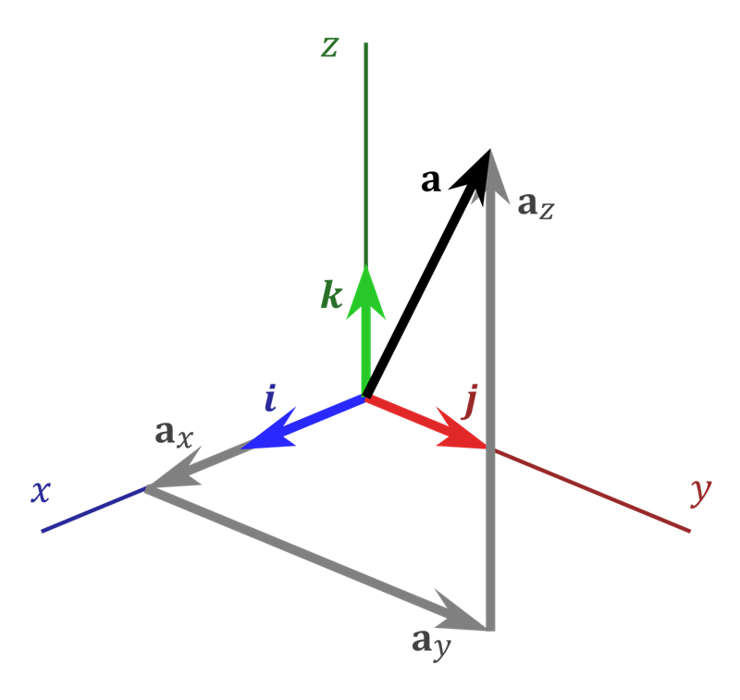

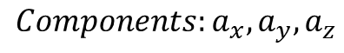
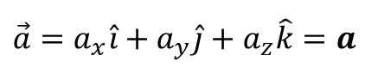
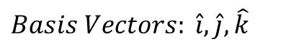

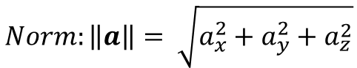
Real Vectors
$$Basis Vectors: \hat{i},\hat{j},\hat{k}$$
Unit Vectors
$$Components:a_{x},a_{y},a_{z}$$
How much of each basis makes up $\vec{a}$
$$\vec{a}=a_{x}\hat{i}+a_{y}\hat{j}+a_{z}\hat{k}=a$$
Vectors are basis independent,
components are not
$$Norm:\left\|a\right\|= \sqrt{a_{x}^{2}+a_{y}^{2}+a_{z}^{2}}$$
In basis $\hat{i},\hat{j},\hat{k}$

Slide 5
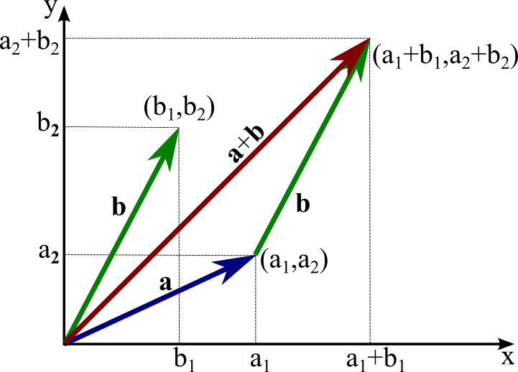
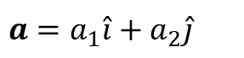
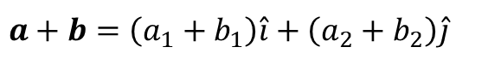
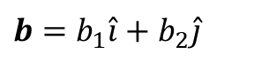
Real Vectors – Addition (Vector + Vector)
$$a=a_{1}\hat{i}+a_{2}\hat{j}$$
$$b=b_{1}\hat{i}+b_{2}\hat{j}$$
$$a+b=\left(a_{1}+b_{1}\right)\hat{i}+\left(a_{2}+b_{2}\right)\hat{j}$$

Slide 6
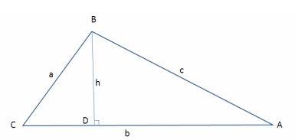


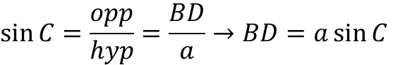
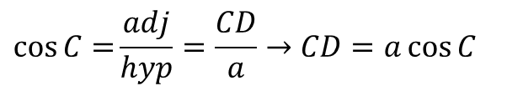

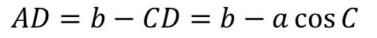
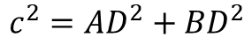

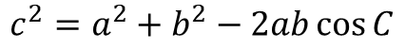
Real Vectors – Dot Product (Vector $⋅$Vector)
In $Δ BCD$:
$$\cos{C=}\frac{adj}{hyp}=\frac{CD}{a}→CD=a\cos{C}$$
$$\sin{C}=\frac{opp}{hyp}=\frac{BD}{a}→BD=a\sin{C}$$
In $Δ ABC$:
$$AD=b−CD=b−a\cos{C}$$
In $Δ ABD$:
Law of Cosines
$$c^{2}={AD}^{2}+{BD}^{2}$$
The square of a side of a triangle equals the sum of the squares of the remaining sides minus twice the product of those sides and the cosine of the angle between them
$$c^{2}={\left(b−a\cos{C}\right)}^{2}+{\left(a\sin{C}\right)}^{2}$$
$$c^{2}=a^{2}\left(\sin^{2}{C}+\cos^{2}{C}\right)+b^{2}−2ab\cos{C}$$
$$c^{2}=a^{2}+b^{2}−2ab\cos{C}$$

Slide 7
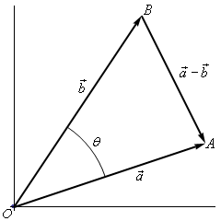
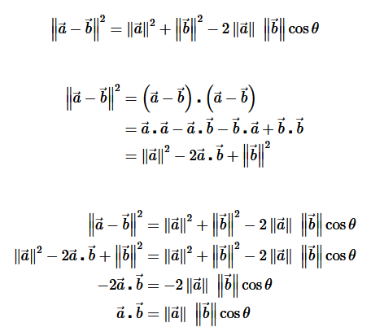
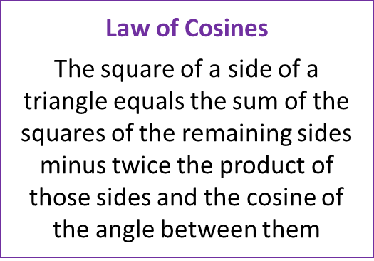
Real Vectors – Dot Product (Vector $⋅$Vector)

Slide 8
Real Vectors – Dot Product (Vector $⋅$Vector)

Slide 9
Real Vectors – Dot Product (Vector $⋅$Vector)

Slide 10
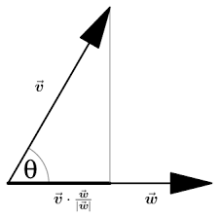
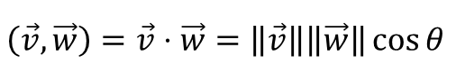

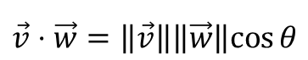

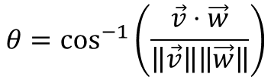
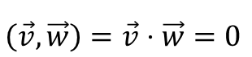
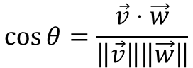
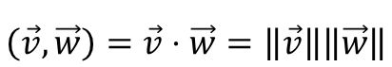
Real Vectors – Dot Product (Vector $⋅$Vector)
$$\vec{v}⋅\vec{w}=\left\|\vec{v}\right\|\left\|\vec{w}\right\|cos{θ}$$
$$\cos{θ}=\frac{\vec{v}⋅\vec{w}}{\left\|\vec{v}\right\|\left\|\vec{w}\right\|}$$
$$θ=\cos^{−1}\left(\frac{\vec{v}⋅\vec{w}}{\left\|\vec{v}\right\|\left\|\vec{w}\right\|}\right)$$
$$\left(\vec{v},\vec{w}\right)=\vec{v}⋅\vec{w}=\left\|\vec{v}\right\|\left\|\vec{w}\right\|\cos{θ}$$
← Dot product (Euclidean)
$$\left(\vec{v},\vec{w}\right)=\vec{v}⋅\vec{w}=\left\|\vec{v}\right\|\left\|\vec{w}\right\|$$
← If parallel $\left(θ=0\right)$
$$\left(\vec{v},\vec{w}\right)=\vec{v}⋅\vec{w}=0$$
← If perpendicular $\left(θ=\frac{π}{2}\right)$

Slide 11

Real Vectors – Dot Product (Vector $⋅$Vector)
For generalized
real vectors
(not necessarily Euclidean 2D)
$$\left(v,w\right)=v⋅w=v_{1}w_{1}+v_{2}w_{2}{+v}_{n}w_{n}$$
← Inner product (produces a scalar)
$$\left(v,v\right)=v⋅v=v_{1}v_{1}+v_{2}v_{2}{+v}_{n}v_{n}={\left\|v\right\|}^{2}$$
$$\left\|v\right\|=\sqrt{v⋅v}$$
The norm of a real vector is the square root of its own inner product

Slide 12

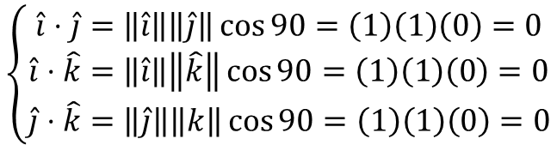
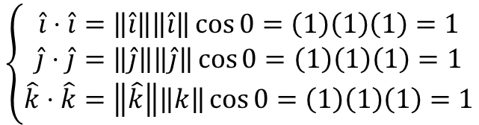
Real Vectors – Dot Product (Vector $⋅$Vector)
Each of these unit vectors lies entirely along itself
$$\left\{\begin{matrix}\hat{i}⋅\hat{i}=\left\|\hat{i}\right\|\left\|\hat{i}\right\|\cos{0}=\left(1\right)\left(1\right)\left(1\right)=1 \\ \hat{j}⋅\hat{j}=\left\|\hat{j}\right\|\left\|\hat{j}\right\|\cos{0}=\left(1\right)\left(1\right)\left(1\right)=1 \\ \hat{k}⋅\hat{k}=\left\|\hat{k}\right\|\left\|k\right\|\cos{0}=\left(1\right)\left(1\right)\left(1\right)=1\end{matrix}\right.$$
$$\left\{\begin{matrix}\hat{i}⋅\hat{j}=\left\|\hat{i}\right\|\left\|\hat{j}\right\|\cos{90}=\left(1\right)\left(1\right)\left(0\right)=0 \\ \hat{i}⋅\hat{k}=\left\|\hat{i}\right\|\left\|\hat{k}\right\|\cos{90}=\left(1\right)\left(1\right)\left(0\right)=0 \\ \hat{j}⋅\hat{k}=\left\|\hat{j}\right\|\left\|k\right\|\cos{90}=\left(1\right)\left(1\right)\left(0\right)=0\end{matrix}\right.$$
No part of these unit vectors lies along any other
$\hat{i},\hat{j},\hat{k}$ are the canonical orthonormal basis vectors in $ℝ^{3}$

Slide 13
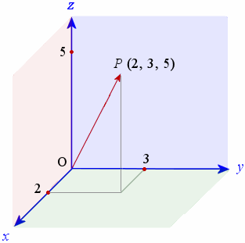

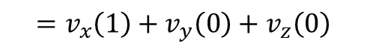
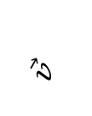
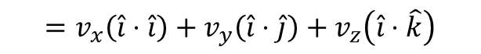

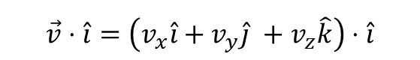


Real Vectors – Dot Product (Vector $⋅$Vector)
$$\vec{v}⋅\hat{i}=\left(v_{x}\hat{i}+v_{y}\hat{j} +v_{z}\hat{k}\right)⋅\hat{i}$$
$$=v_{x}\left(\hat{i}⋅\hat{i}\right)+v_{y}\left(\hat{i}⋅\hat{j}\right)+v_{z}\left(\hat{i}⋅\hat{k}\right)$$
$$\vec{v}$$
$$=v_{x}\left(1\right)+v_{y}\left(0\right)+v_{z}\left(0\right)$$
$$=v_{x}$$
$$\vec{v}⋅\hat{i}=v_{x}$$
We can get the individual components of a real vector by forming the dot product with each of its basis vectors
$$\vec{v}⋅\hat{j}=v_{y}$$
$$\vec{v}⋅\hat{k}=v_{z}$$

Slide 14
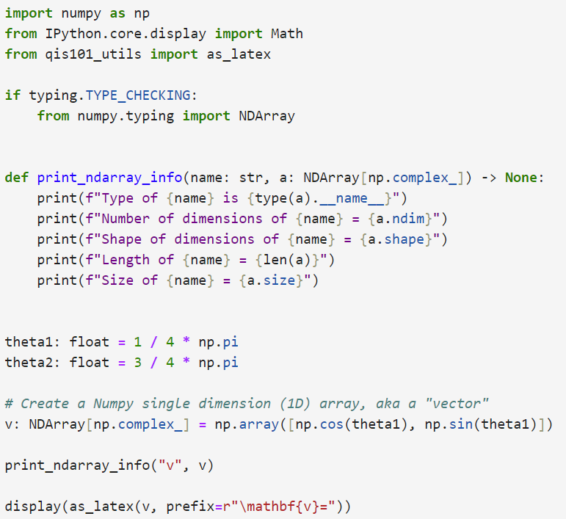

Open real_vectors.ipynb
①
②
③
④
⑥
⑤
⑦
⑤ → You can create a Numpy ndarray from a Python list using np.array()

Slide 15
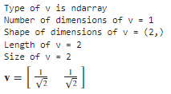
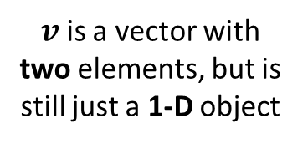
Run Cell 1 – real_vectors.ipynb
$v$ is a vector with two elements, but is still just a 1-D object
Notice the comma with nothing after it
len() only returns the number of items in the
1st dimension of an np.ndarray

Slide 16
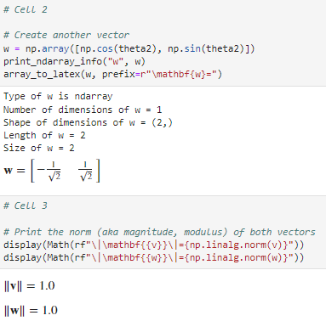
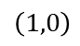
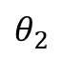
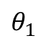
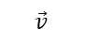
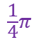
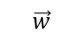
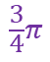
Run Cells 2 & 3 – real_vectors.ipynb
$$\vec{w}$$
$$\vec{v}$$
$$\frac{3}{4}π$$
$$θ_{2}$$
$$θ_{1}$$
$$\frac{1}{4}π$$
$$\left(1,0\right)$$
①

Slide 17
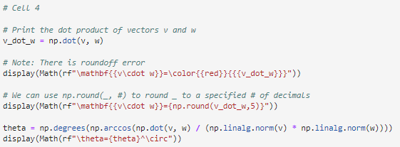
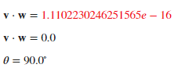
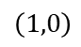
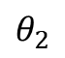
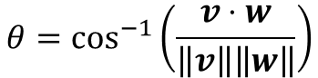





Run Cell 4 – real_vectors.ipynb
①
②
③
④
$$\vec{w}$$
$$\vec{v}$$
$$\frac{3}{4}π$$
$$θ_{2}$$
$$θ_{1}$$
$$\frac{1}{4}π$$
$$\left(1,0\right)$$
$$θ=\cos^{−1}\left(\frac{v⋅w}{\left\|v\right\|\left\|w\right\|}\right)$$

Slide 18


Run Cell 5 – real_vectors.ipynb
①
②
LaTeX Math Symbols - Handy Reference

Slide 19



Run Cell 6 – real_vectors.ipynb
①
①

Slide 20
Symbols and Operators
$c_{n},z_{n}$ = Complex Scalar
$\vec{v}, v$ = Vector (1D array)
$v_{n}$= Vector Components
= Vector Norm
$⋅$ = Dot Product
= Inner Product
$⨂$ = Tensor Product
$A$ = Matrix (2D array)
$A^{−1}$= Inverse
$A^{T}$= Transpose
$A^{†}$= Adjoint
$Tr\left(A\right)$ = Trace
$I$ = Identity Matrix
$H$ = Hadamard Matrix

Slide 21
Matrices
A “matrix” in NumPy is represented as vectors of vectors
A matrix can hold any number of elements (in each dimension), but all elements must be of the same data type, such as int or float
Matrix elements are accessed by their index numbers, which starts at zero and correspond to each dimension
Matrix nomenclature
In mathematics, a matrix size is written as (Rows x Columns)
In NumPy a matrix (aka a ndarray) is written using commas instead of multiplication crosses, and using square brackets instead of parenthesis: [Row, Column]
Example: the NumPy array [5,7] has 5 rows and 7 columns

Slide 22


Types of Matrices
Identity Matrix

Slide 23

Matrix Multiplication
When rendering computer graphics, we often need to find the product of two matrices, e.g.
$$\left(\begin{matrix}4 & 5 & 8 \\ 1 & 9 & 7\end{matrix}\right)⋅\left(\begin{matrix}2 & 4 \\ 6 & 1 \\ 5 & 9\end{matrix}\right)= ?$$
There is a standard algorithm to do this multiplication
It involves multiplying each element in the rows of first matrix by each element in the columns of the second matrix

Slide 24
Matrix Multiplication
In order to multiply two matrices together, the number of columns in matrix A must equal the number of rows in matrix B (Cols A = Rows B)
The resulting matrix will have as many rows as there were rows in matrix A, and as many columns as there were columns in matrix B (Rows A x Cols B)

Slide 25


Matrix Multiplication
Example
Matrix A has dimension (2 x 3) = 2 rows, 3 columns
Matrix B has dimension (3 x 2) = 3 rows, 2 columns
$$\left(\begin{matrix}4 & 5 & 8 \\ 1 & 9 & 7\end{matrix}\right)⋅\left(\begin{matrix}2 & 4 \\ 6 & 1 \\ 5 & 9\end{matrix}\right)= ?$$
The inner values must match!
A
B
(2 x 3) $⋅$ (3 x 2)
A
B
The outer values will be
the dimension of the final
matrix product!

Slide 26

Matrix Multiplication
Matrix multiplication is not commutative!
If we multiple A x B we may get a different matrix than if we multiply B x A
(3 x 2) $⋅$ (2 x 3) = result is a (3 x 3) matrix
(2 x 3) $⋅$ (3 x 2) = result is a (2 x 2) matrix
You might not even be able to multiply in the reverse order
(2 x 3) $⋅$ (3 x 5) = result is a (2 x 5) matrix
(3 x 5) $⋅$ (2 x 3) = Not allowed (5 $≠$ 2)aaa
Welcome to the world of non-commutative algebra
This is very strange – it catches even great physicists by surprise!
This asymmetry is the foundation of the matrix formulation of quantum mechanics

Slide 27

Matrix Multiplication
The algorithm is simple but tedious for A $∙$ B = C
Sum the product of every element in each row of matrix A and the corresponding element in each column of matrix B
That sum becomes just one element in new matrix C
Continue this process for all rows in matrix A
Every row in A gets multiplied by every column in B
The resulting matrix will have dimensions (Rows A x Cols B)

Slide 28

Matrix Multiplication

Slide 29
Matrix Multiplication

Slide 30
Matrix Multiplication

Slide 31
Matrix Multiplication

Slide 32
Matrix Multiplication

Slide 33

Open matrix_algebra.ipynb
①
②
③
④

Slide 34

Run Cell 1 – matrix_algebra.ipynb
①
len() only returns the number of items in the
1st dimension of an np.ndarray
②
③
④
⑤
⑥

Slide 35


Run Cells 2 & 3 – matrix_algebra.ipynb
①
②
See slide #32
③
$$3×2∙2×3=3×3$$

Slide 36



Run Cell 4 – matrix_algebra.ipynb
Operand 0 (b)
Operand 1 (a)
$$3×2∙3×3=Error!$$
Dimension 0
Generalized Universal Function API

Slide 37
Determinant of a Matrix
In linear algebra, the determinant is a value that can be computed from the elements of a square matrix
The determinant can be used:
To solve a system of linear equations when those equations are represented by a matrix
To find the Jacobian of the matrix of all first-order partial derivatives of a vector-valued function
To calculate the characteristic polynomial of a matrix which is essential for eigenvalue problems
To express the signed n-dimensional volumes of n-dimensional parallelepipeds in analytic geometry

Slide 38
Determinant of a Matrix
Calculating the Determinant of a 2 x 2 Matrix
$$A=\left[\begin{matrix}a_{11} & a_{12} \\ a_{21} & a_{22}\end{matrix}\right]→\det{A}=\left|A\right|=\left|\begin{matrix}a_{11} & a_{12} \\ a_{21} & a_{22}\end{matrix}\right|$$
$$det\left[\begin{matrix}a_{11} & a_{12} \\ a_{21} & a_{22}\end{matrix}\right]=a_{11}∙a_{22}−a_{12}∙a_{21}$$
$$det\left[\begin{matrix}a_{11} & a_{12} \\ a_{21} & a_{22}\end{matrix}\right]=a_{11}∙a_{22}−a_{12}∙a_{21}$$

Slide 39
Determinant of a Matrix
Calculating the Determinant of a 2 x 2 Matrix
$$A=\left[\begin{matrix}a_{11} & a_{12} \\ a_{21} & a_{22}\end{matrix}\right]→\det{A}=\left|A\right|=\left|\begin{matrix}a_{11} & a_{12} \\ a_{21} & a_{22}\end{matrix}\right|$$
$$det\left[\begin{matrix}a_{11} & a_{12} \\ a_{21} & a_{22}\end{matrix}\right]=a_{11}∙a_{22}−a_{12}∙a_{21}$$
$$det\left[\begin{matrix}8 & 3 \\ 4 & 2\end{matrix}\right]=8∙2 −3∙4=16−12=4$$

Slide 40
Determinant of a Matrix
Calculating the Determinant of a 3 x 3 Matrix
$$\det{A}=\left|A\right|=\left|\begin{matrix}a_{11} & a_{12} & a_{13} \\ a_{21} & a_{22} & a_{23} \\ a_{31} & a_{32} & a_{33}\end{matrix}\right|$$
$$\left|A\right|=a_{11}\left|\begin{matrix}a_{22} & a_{23} \\ a_{32} & a_{33}\end{matrix}\right|−a_{21}\left|\begin{matrix}a_{12} & a_{13} \\ a_{32} & a_{33}\end{matrix}\right|+a_{31}\left|\begin{matrix}a_{12} & a_{13} \\ a_{22} & a_{23}\end{matrix}\right|$$

Slide 41
Determinant of a Matrix
Calculating the Determinant of a 3 x 3 Matrix
$$\det{A}=\left|A\right|=\left|\begin{matrix}a_{11} & a_{12} & a_{13} \\ a_{21} & a_{22} & a_{23} \\ a_{31} & a_{32} & a_{33}\end{matrix}\right|$$
$$\left|A\right|=a_{11}\left|\begin{matrix}a_{22} & a_{23} \\ a_{32} & a_{33}\end{matrix}\right|−a_{21}\left|\begin{matrix}a_{12} & a_{13} \\ a_{32} & a_{33}\end{matrix}\right|+a_{31}\left|\begin{matrix}a_{12} & a_{13} \\ a_{22} & a_{23}\end{matrix}\right|$$

Slide 42
Determinant of a Matrix
Calculating the Determinant of a 3 x 3 Matrix
$$\det{A}=\left|A\right|=\left|\begin{matrix}a_{11} & a_{12} & a_{13} \\ a_{21} & a_{22} & a_{23} \\ a_{31} & a_{32} & a_{33}\end{matrix}\right|$$
$$\left|A\right|=a_{11}\left|\begin{matrix}a_{22} & a_{23} \\ a_{32} & a_{33}\end{matrix}\right|−a_{21}\left|\begin{matrix}a_{12} & a_{13} \\ a_{32} & a_{33}\end{matrix}\right|+a_{31}\left|\begin{matrix}a_{12} & a_{13} \\ a_{22} & a_{23}\end{matrix}\right|$$

Slide 43
Determinant of a Matrix
Calculating the Determinant of a 3 x 3 Matrix
$$\det{A}=\left|A\right|=\left|\begin{matrix}a_{11} & a_{12} & a_{13} \\ a_{21} & a_{22} & a_{23} \\ a_{31} & a_{32} & a_{33}\end{matrix}\right|$$
$$\left|A\right|=a_{11}\left|\begin{matrix}a_{22} & a_{23} \\ a_{32} & a_{33}\end{matrix}\right|−a_{21}\left|\begin{matrix}a_{12} & a_{13} \\ a_{32} & a_{33}\end{matrix}\right|+a_{31}\left|\begin{matrix}a_{12} & a_{13} \\ a_{22} & a_{23}\end{matrix}\right|$$

Slide 44

Determinant of a Matrix
Calculating the Determinant of a 4 x 4 Matrix
Notice the definition of determinant is inherently recursive:
The determinant of a $n x n$matrix is calculated from the determinants of $n$ reduced matrices of size $(n−1)×(n−1)$,
and so on and so on, getting down to simple 2 x 2 matrices

Slide 45
Determinant of a Matrix
Calculating the Determinant of a 4 x 4 Matrix
These smaller matrices, where a row and column has been removed, are called the cofactors of the original (larger) matrix
Notice the sign in front of each cofactor alternates from positive (+1) to negative (-1)

Slide 46

Run Cell 5 – matrix_algebra.ipynb
①
②
③
①
②
③

Slide 47


Run Cell 6 – matrix_algebra.ipynb
①
②
③
Determinants can get quite large!

Slide 48

Determinant of a Matrix
Always seek independent confirmation!

Slide 49






Goal: Solve a System of Linear Equations
Two Equations and Two Unknowns
$$4x+7y=47$$
$$ax+by=c$$
$$a=4, b=7, c=47$$
$$3x−5y=−16$$
$$dx+ey=f$$
$$d=3,e=−5,f=−16$$
$$ax=c−by$$
$$\frac{d(c−by)}{a}+ey=f$$
$$x=\frac{c−by}{a}$$
$$cd−bdy+aey=af$$
$$y\left(ae−bd\right)=af−cd$$
$$y=\frac{\left(4\right)\left(−16\right)−(47)(3)}{\left(4\right)\left(−5\right)−(7)(3)}=\frac{−205}{−41}=5$$
$$y=\frac{af−cd}{ae−bd}$$

Slide 50

Goal: Solve a System of Linear Equations
Two Equations and Two Unknowns
$$4x+7y=47$$
$$ax+by=c$$
$$a=4, b=7, c=47$$
$$3x−5y=−16$$
$$dx+ey=f$$
$$d=3,e=−5,f=−16$$
$$by=c−ax$$
$$dx+\frac{e(c−ax)}{b}=f$$
$$y=\frac{c−ax}{b}$$
$$bdx+ce−aex=bf$$
$$x\left(bd−ae\right)=bf−ce$$
$$x=\frac{\left(47\right)\left(−5\right)−(7)(−16)}{\left(4\right)\left(−5\right)−(7)(3)}=\frac{−123}{−41}=3$$
$$x=\frac{bf−ce}{bd−ae}\left(\frac{−1}{−1}\right)=\frac{ce−bf}{ae−bd}$$

Slide 51



Goal: Solve a System of Linear Equations
Two Equations and Two Unknowns
$$4x+7y=47$$
$$ax+by=c$$
$$a=4, b=7, c=47$$
$$3x−5y=−16$$
$$dx+ey=f$$
$$d=3,e=−5,f=−16$$
$$x=\frac{ce−bf}{ae−bd}$$
$$y=\frac{af−cd}{ae−bd}$$
$$\det{C=\left|\begin{matrix}a & b \\ d & e\end{matrix}\right|=ae−bd}$$
$$\left|C\right|=\left(4\right)\left(−5\right)−\left(7\right)\left(3\right)=−41$$

Slide 52
Goal: Solve a System of Linear Equations
Two Equations and Two Unknowns
$$ax+by=c$$
Overlay the x coefficients with the RHS values
$$dx+ey=f$$
$$\det{A=\left|\begin{matrix}c & b \\ f & e\end{matrix}\right|=ce−bf}$$
$$x=\frac{ce−bf}{ae−bd}$$
$$y=\frac{af−cd}{ae−bd}$$
$$\det{C=\left|\begin{matrix}a & b \\ d & e\end{matrix}\right|=ae−bd}$$
$$\left|A\right|=\left(47\right)\left(−5\right)−\left(7\right)\left(−16\right)=−123$$
$$\left|C\right|=\left(4\right)\left(−5\right)−\left(7\right)\left(3\right)=−41$$

Slide 53
Goal: Solve a System of Linear Equations
Two Equations and Two Unknowns
$$ax+by=c$$
Overlay the y coefficients with the RHS values
$$dx+ey=f$$
$$\det{A=\left|\begin{matrix}c & b \\ f & e\end{matrix}\right|=ce−bf}$$
$$x=\frac{ce−bf}{ae−bd}$$
$$\det{B=\left|\begin{matrix}a & c \\ d & f\end{matrix}\right|=af−cd}$$
$$y=\frac{af−cd}{ae−bd}$$
$$\det{C=\left|\begin{matrix}a & b \\ d & e\end{matrix}\right|=ae−bd}$$
$$\left|A\right|=\left(47\right)\left(−5\right)−\left(7\right)\left(−16\right)=−123$$
$$\left|B\right|=\left(4\right)\left(−16\right)−\left(47\right)\left(3\right)=−205$$
$$\left|C\right|=\left(4\right)\left(−5\right)−\left(7\right)\left(3\right)=−41$$

Slide 54




Goal: Solve a System of Linear Equations
Two Equations and Two Unknowns
$$4(3)+7(5)=47$$
$$ax+by=c$$
$$3(3)−5(5)=−16$$
$$dx+ey=f$$
$$\det{A=\left|\begin{matrix}c & b \\ f & e\end{matrix}\right|=ce−bf}$$
$$x=\frac{ce−bf}{ae−bd}$$
$$x=\frac{\left|A\right|}{\left|C\right|}$$
$$\det{B=\left|\begin{matrix}a & c \\ d & f\end{matrix}\right|=af−cd}$$
$$y=\frac{af−cd}{ae−bd}$$
$$y=\frac{\left|B\right|}{\left|C\right|}$$
$$\det{C=\left|\begin{matrix}a & b \\ d & e\end{matrix}\right|=ae−bd}$$
$$x=\frac{\left|A\right|}{\left|C\right|}=\frac{−123}{−41}=3$$
$$\left|A\right|=\left(47\right)\left(−5\right)−\left(7\right)\left(−16\right)=−123$$
$$\left|B\right|=\left(4\right)\left(−16\right)−\left(47\right)\left(3\right)=−205$$
$$y=\frac{\left|B\right|}{\left|C\right|}=\frac{−205}{−41}=5$$
$$\left|C\right|=\left(4\right)\left(−5\right)−\left(7\right)\left(3\right)=−41$$

Slide 55

Goal: Solve a System of Linear Equations
Three Equations and Three Unknowns

Slide 56

Cramer’s Rule
We create one overlay matrix for each unknown

Slide 57

Run Cell 7 – matrix_algebra.ipynb
①
②
①
②

Slide 58


Run Cell 8 – matrix_algebra.ipynb
①
②
③
④
⑤
⑥
⑦
⑧

Slide 59

Run Cell 9 – matrix_algebra.ipynb
①
②

Slide 60




Matrix Transpose (T)
Interchange Rows for Columns
$$\left[\begin{matrix}v_{0} \\ v_{1} \\ v_{2} \\ v_{3}\end{matrix}\right]={\left[v_{0},v_{1}{,v}_{2},v_{3}\right]}^{T}$$
To save print space, authors often write a vector as a row matrix followed by the T operator
A vector can be written as a column matrix…
…or as a row matrix
$$(1, 4)$$
$$(4, 1)$$

Slide 61







Matrix Inversion
Non-square matrices are not directly invertible
Matrix Division
Solve System of Linear Equations
$$\frac{A}{B}=A⋅B^{−1}$$
$$A⋅x=B$$
$$A^{−1}⋅\left(A⋅x\right)=A^{−1}⋅B$$
$$\left(A^{−1}⋅A\right)⋅x=A^{−1}⋅B$$
$$I⋅x=A^{−1}⋅B$$
$$x=A^{−1}⋅B$$

Slide 62




Matrix Adjoint (H) and Trace
Aka "Dagger" →
$$A^{†}={\left(\overline{A}\right)}^{T}=\overline{A^{T}}=A^{H}$$
← Hermitian adjoint
$$Tr\left[\begin{matrix}a & b & c \\ d & e & f \\ g & h & i\end{matrix}\right]=a+e+i$$
The "Trace" →
Note: Only square matrices have a trace!

Slide 63





Hermitian Matrix
All Hermitian matrices are square and equal to their own conjugate transpose
$∴$ all diagonal elements $∈ ℝ$
A matrix is Hermitian if
Charles Hermite
(1822-1901)
$$A^{†}=A$$
Note: H may also refer to a Hadamard Matrix

Slide 64







Complex Vector Algebra
$$v+w=\left(v+w\right)$$
Vector Addition
$$\left(−v\right)=−\left(v\right)$$
Additive Inverse
$$c⋅v=\left(c∙v\right)$$
Scalar Multiplication
Scalar doesn't mean only $∈ℝ$

Slide 65









Complex Scalar Multiplication
$$v=v_{1}\hat{i}+v_{2}\hat{j}+v_{3}\hat{k}$$
$$v_{1},v_{2},v_{3}∈ℝ or ℂ$$
$$\left\|v\right\|=\sqrt{{\left|v_{1}\right|}^{2}+{\left|v_{2}\right|}^{2}+{\left|v_{3}\right|}^{2}}$$
Unit basis vectors have length = 1
$$z∈ℂ$$
$$\left|z\right|⋅\left\|v\right\|=\left|z\right|\sqrt{{\left|v_{1}\right|}^{2}+{\left|v_{2}\right|}^{2}+{\left|v_{3}\right|}^{2}}$$
$$\left|z\right|∈ℝ$$
$$\left\|\left|z\right|⋅v\right\|=\sqrt{{\left(\left|z\right|{⋅v}_{1}\hat{i}\right)}^{2}+{\left(\left|z\right|⋅v_{2}\hat{j}\right)}^{2}+{\left(\left|z\right|⋅v_{3}\hat{k}\right)}^{2}}$$
Real Scalar Multiplication respects Norms
$$= \sqrt{{\left|z\right|}^{2}\left({\left|v_{1}\right|}^{2}+{\left|v_{2}\right|}^{2}+{\left|v_{3}\right|}^{2}\right)}$$
$$=\left|z\right|\sqrt{{\left|v_{1}\right|}^{2}+{\left|v_{2}\right|}^{2}+{\left|v_{3}\right|}^{2}}$$
$$=\left|z\right|∙\left\|v\right\|$$

Slide 66
Complex Inner Product
Column Matrix
Column Matrix
numpy.vdot() and Qiskit
$$v=\left[\begin{matrix}7−2i \\ 4i \\ 11+6i \\ −15\end{matrix}\right]$$
$$w=\left[\begin{matrix}−3−5i \\ 2+9i \\ −12i \\ 1+8i\end{matrix}\right]$$
$$\left\langle v,w\right\rangle =v^{†}⋅w=\left\langle v\left|w\right.\right\rangle$$
$$w$$
$$\left[\begin{matrix}7+2i & −4i & 11−6i & −15\end{matrix}\right]⋅\left[\begin{matrix}−3−5i \\ 2+9i \\ −12i \\ 1+8i\end{matrix}\right]=\begin{matrix}\left(7+2i\right)\left(−3−5i\right) \\ (0−4i)(2+9i) \\ (11−6i)(0−12i) \\ (−15+0i)(1+8i)\end{matrix}=+ \begin{matrix}\begin{aligned}−11−41i \\ 36−8i\end{aligned} \\ \begin{aligned}−72−132i \\ −15−120i\end{aligned}\end{matrix}$$
$$v^{†}$$
(1 x 4) • (4 x 1) = (1 x 1) $→$ Scalar
$$\left\langle v,w\right\rangle =−62−301i$$
The complex inner product of
two vectors uses the
dot product to produce a scalar
but needs the adjoint of the first vector
Inner Product of Square Matrices
$$\left\langle A,B\right\rangle =Tr\left(A^{†}⋅B\right)$$
If $A$ and $B$ have same dimensions

Slide 67








Complex Vector Norm
$$v=\left[\begin{matrix}7−2i \\ 4i \\ 11+6i \\ −15\end{matrix}\right]$$
$$\left\|v\right\|=\sqrt{\left\langle v,v\right\rangle }=\sqrt{v^{†}⋅v}=\sqrt{{\left(\overline{v}\right)}^{T}⋅v}$$
The "norm" of a vector of complex numbers must be a positive real scalar
because length cannot be negative or imaginary
$$\left[\begin{matrix}7+2i & −4i & 11−6i & 15\end{matrix}\right]⋅\left[\begin{matrix}7−2i \\ 4i \\ 11+6i \\ 15\end{matrix}\right]=\left[\begin{matrix}\left(7+2i\right)\left(7−2i\right) \\ \left(−4i\right)\left(4i\right) \\ \left(11−6i\right)\left(11+6i\right) \\ \left(15\right)\left(15\right)\end{matrix}\right]=\left[\begin{matrix}53 \\ 16 \\ 157 \\ 225\end{matrix}\right]=451$$
$$v^{†}$$
$$v$$
$$\left\|v\right\|=\left[\begin{matrix}7+2i & −4i & 11−6i & −15\end{matrix}\right]⋅\left[\begin{matrix}7−2i \\ 4i \\ 11+6i \\ 15\end{matrix}\right]=\sqrt{451}=21.23676…$$
$$v^{†}$$
$$v$$
$$=\sqrt{v^{†}⋅v}=\sqrt{\left\langle v,v\right\rangle }$$

Slide 68






Unitary Matrices
$$U=\left[\begin{matrix}\frac{1}{\sqrt{2}} & 0 & \frac{1}{\sqrt{2}} & 0 \\ 0 & \frac{1}{\sqrt{2}} & 0 & \frac{1}{\sqrt{2}} \\ \frac{1}{\sqrt{2}} & 0 & −\frac{1}{\sqrt{2}} & 0 \\ 0 & \frac{1}{\sqrt{2}} & 0 & −\frac{1}{\sqrt{2}}\end{matrix}\right]$$
$$U=\left[\begin{matrix}\cos{θ} & \sin{θ} & 0 \\ −sin{θ} & \cos{θ} & 0 \\ 0 & 0 & 1\end{matrix}\right]$$
Clockwise Rotation Matrix
$$U^{†}=\left[\begin{matrix}\cos{θ} & −\sin{θ} & 0 \\ \sin{θ} & \cos{θ} & 0 \\ 0 & 0 & 1\end{matrix}\right]$$
Counterclockwise Rotation Matrix
A Unitary Matrix Respects Norms
$$U⋅U^{†}=U^{†}⋅U=I$$
$$\left\|U⋅v\right\|=\sqrt{\left\langle U⋅v,U⋅v\right\rangle }=\left\|v\right\|$$
Unitary matrices are invertible, their inverse is their adjoint, and they preserve norms
A unitary matrix "preserves the geometry" (lengths & relative angles) of the space is acts upon
$U^{†}$ can "undo" $U$
Reversible Computation

Slide 69

Complex Vector & Matrix Identities
$\left\langle v,v\right\rangle ={\left\|v\right\|}^{2}$
The inner product of a vector with itself is its squared norm
$\left\langle v,v\right\rangle =\overline{\left\langle v,v\right\rangle }$
An inner product is equal to its own conjugate
${\left(A+B\right)}^{†}=A^{†}+B^{†}$
The adjoint (dagger) operator is distributive across matrix addition
$\left\langle v,w\right\rangle =Tr\left(v^{†}⋅w\right)$
The inner product of two equal length vectors is equal to the trace of their dot product
$Tr\left[xA+yB\right]=xTr\left[A\right]+yTr\left[B\right]$
The trace operator is distributive across scalar-array multiplication

Slide 70



Open complex_matrices.ipynb
t1
t2
$$\left\langle v,v\right\rangle ={\left\|v\right\|}^{2}$$
①
②
Transposing a vector (which is inherently one-dimensional) really does nothing
③

Slide 71

Run Cell 1 – complex_matrices.ipynb
$$\left\langle v,v\right\rangle ={\left\|v\right\|}^{2}$$
Transposing a vector (which is inherently one-dimensional) really does nothing

Slide 72



Run Cell 2 – complex_matrices.ipynb
t1
t2
$$\left\langle v,v\right\rangle =\overline{\left\langle v,v\right\rangle }$$
①
①
②
②
What are the differences between $...$ and $$...$$ ???

Slide 73


Run Cell 3 – complex_matrices.ipynb
t1
t2
$${\left(A+B\right)}^{†}=A^{†}+B^{†}$$
Now we do need to use .T because we are dealing with 2D arrays (matrices)
There is no simple equality test for numpy matrices so
we must use the .all() method after .isclose()

Slide 74


Run Cell 4 – complex_matrices.ipynb
t1
t2
$$\left\langle v,w\right\rangle =Tr\left(v^{†}⋅w\right)$$
$$v^{†}$$
$$w$$
$$\left(4×1\right)⋅\left(1×4\right)=\left(4×4\right)$$
①

Slide 75



Run Cell 5 – complex_matrices.ipynb
t1
t2
$$Tr\left[xA+yB\right]=xTr\left[A\right]+yTr\left[B\right]$$
①
②
②

Slide 76

Complex Vector & Matrix Identities
$\left\langle A⋅v,w\right\rangle =\left\langle v,A⋅w\right\rangle$if and only if $A hermitian$
Within an inner product, a Hermitian matrix can be dotted to either vector
$\left\|v\right\|=\left\|U⋅v\right\|=\sqrt{\left\langle U⋅v,U∙v\right\rangle } if U unitary$
The dot product of a Unitary matrix with a vector respects the norm
$\left\langle v,w\right\rangle =\overline{\left\langle w,v\right\rangle }$
Commutation of two vectors within an inner product produces the conjugate of that inner product
$\left|\left\langle v,w\right\rangle \right|≤\left\|v\right\|\left\|w\right\|$
Demonstrate the Cauchy–Schwarz inequality (“co-she”)
${\left(A⋅B\right)}^{†}=B^{†}⋅A^{†}$
The adjoint operator is distributive across a commutated dot product

Slide 77




Run Cell 6 – complex_matrices.ipynb
t1
t2
$$\left\langle A⋅v,w\right\rangle =\left\langle v,A⋅w\right\rangle iff A hermitian$$
①
Matrix $A$ is Hermitian
$$A=A^{†}$$

Slide 78


Run Cell 7 – complex_matrices.ipynb
t1
t2
$$\left\|v\right\|=\left\|U⋅v\right\|=\sqrt{\left\langle U⋅v,U∙v\right\rangle } if U unitary$$
①
①
②
③
②
④
④

Slide 79



Run Cell 8 – complex_matrices.ipynb
t1
t2
$$\left\langle v,w\right\rangle =\overline{\left\langle w,v\right\rangle }$$
①
①
②
②

Slide 80





Run Cell 9 – complex_matrices.ipynb
t1
t2
$$\left|\left\langle v,w\right\rangle \right|≤\left\|v\right\|\left\|w\right\|$$
①
②

Slide 81



Run Cell 10 – complex_matrices.ipynb
t1
t2
$${\left(A⋅B\right)}^{†}=B^{†}⋅A^{†}$$
①
Now we do need to use .T because we are dealing with 2D arrays (matrices)
②

Slide 82



Run Cell 11 – complex_matrices.ipynb
$\left\|c⋅v\right\|=\left|c\right|∙\left\|v\right\|$
Complex scalar multiplication respects a vector's norm
①
②

Slide 83




Basis Sets
$$v=c_{0}⋅v_{0}+c_{1}⋅v_{1}+c_{2}⋅v_{2}+c_{n−1}⋅v_{n−1}$$
The set of linearly independent vectors $\left\{v_{0},v_{1},v_{2},v_{n−1}\right\}$ is called the basis set for $v$
$v_{0}=\left[\begin{matrix}1 \\ 0 \\ ⋮ \\ 0\end{matrix}\right],v_{1}=\left[\begin{matrix}0 \\ 1 \\ ⋮ \\ 0\end{matrix}\right],v_{2}=\left[\begin{matrix}0 \\ ⋮ \\ 1 \\ 0\end{matrix}\right],$ $v_{n−1}=\left[\begin{matrix}0 \\ 0 \\ ⋮ \\ 1\end{matrix}\right]$
This is the canonical basis set for $C^{n}$
Basis vectors can have elements of any value (not just 1)
but must all remain linearly independent
$$v=\sum_{j=0}^{n−1}{\left(c_{j}⋅v_{j}\right)}$$
Every vector is a linear sum of amplitudes and its basis vectors

Slide 84






Basis Sets
Orthogonal Basis
$$\left(\vec{u},\vec{v},\vec{w}\right)$$
All perpendicular, but $\left|\left(\vec{u},\vec{v},\vec{w}\right)\right| ≠ 1$
Orthonormal Basis
$$\left(\hat{i},\hat{j},\hat{k}\right)$$
All perpendicular, and $\left|\left(\hat{i},\hat{j},\hat{k}\right)\right|= 1$

Slide 85
















Change of Basis (Transition Matrix)
Basis Set $𝔅$
Basis Set $𝔇$
$v_{𝕭}$ = Vector $v$ expressed using basis $𝕭$
$$𝕭=\left\{\left[\begin{matrix}1 \\ −3\end{matrix}\right],\left[\begin{matrix}−2 \\ 4\end{matrix}\right]\right\}$$
$$𝕯=\left\{\left[\begin{matrix}−7 \\ 9\end{matrix}\right],\left[\begin{matrix}−5 \\ 7\end{matrix}\right]\right\}$$
$v_{𝕯}$ = Vector $v$ expressed using basis $𝕯$
$$v=\left[\begin{matrix}7 \\ −17\end{matrix}\right]=3\left[\begin{matrix}1 \\ −3\end{matrix}\right]−2\left[\begin{matrix}−2 \\ 4\end{matrix}\right]$$
$$v_{𝕯}=M_{𝕯←𝕭}⋅v_{𝕭}$$
$$v_{𝕭}=\left[\begin{matrix}3 \\ −2\end{matrix}\right]$$
$$M_{𝕯←𝕭}=\left[\begin{matrix}2 & \frac{−3}{2} \\ −3 & \frac{5}{2}\end{matrix}\right]$$
A Transition Matrix
$$v_{𝕯}=\left[\begin{matrix}9 \\ −14\end{matrix}\right]$$
$$M_{𝕯←𝕭}=𝕯^{−1}⋅𝕭$$
$$v_{𝕯}=M_{𝕯←𝕭}⋅v_{𝕭}=\left[\begin{matrix}2 & \frac{−3}{2} \\ −3 & \frac{5}{2}\end{matrix}\right]\left[\begin{matrix}3 \\ −2\end{matrix}\right]=\left[\begin{matrix}9 \\ −14\end{matrix}\right]$$
$$\left(2×2\right)⋅\left(2×1\right)=\left(2×1\right)$$
The original vector $v$ does not change, only the components of $v$ change per each basis set
$$v=\left[\begin{matrix}7 \\ −17\end{matrix}\right]=9\left[\begin{matrix}−7 \\ 9\end{matrix}\right]−14\left[\begin{matrix}−5 \\ 7\end{matrix}\right]$$

Slide 86







Change of Basis (Transition Matrix)
$$𝕯=\left\{\left[\begin{matrix}\frac{1}{\sqrt{2}} \\ \frac{1}{\sqrt{2}}\end{matrix}\right],\left[\begin{matrix}\frac{1}{\sqrt{2}} \\ −\frac{1}{\sqrt{2}}\end{matrix}\right]\right\}$$
$$𝕭=\left\{\left[\begin{matrix}1 \\ 0\end{matrix}\right],\left[\begin{matrix}0 \\ 1\end{matrix}\right]\right\}$$
Canonical
(aka Standard or Default) basis set in $ℝ^{2}$
(Cartesian Coordinates)
$$v_{𝕯}=M_{𝕯←𝕭}⋅v_{𝕭}$$
Jacques Hadamard
(1865-1963)
$$M_{𝕯←𝕭}=\frac{1}{\sqrt{2}}\left[\begin{matrix}1 & 1 \\ 1 & −1\end{matrix}\right]=H$$
Hadamard Matrix
Applying the Hadamard Matrix twice undoes the basis change…
$${\left(\frac{1}{\sqrt{2}}\left[\begin{matrix}1 & 1 \\ 1 & −1\end{matrix}\right]\right)}^{2}=\frac{1}{2}\left[\begin{matrix}2 & 0 \\ 0 & 2\end{matrix}\right]=I$$
…because the Hadamard Matrix is a Unitary Matrix

Slide 87



Eigenvectors and Eigenvalues
A matrix (an operator) acts (via the dot product) on a vector
If the dot product of a matrix and a vector yields a scalar multiple of that vector, then that vector is called an eigenvector of the matrix, and that scalar multiple is called an eigenvalue
An operator (matrix) owns its eigenvectors and eigenvalues
("eigen" is German for possession)
$$A⋅v=λ⋅v$$
$$\left[\begin{matrix}4 & −1 \\ 2 & 1\end{matrix}\right]\left[\begin{matrix}1 \\ 2\end{matrix}\right]=2\left[\begin{matrix}1 \\ 2\end{matrix}\right]$$
The solutions to the characteristic polynomial of a square matrix are its eigenvalues
All square $n×n$ matrices have exactly$n$ complex eigenvalues with multiplicity
(Fundamental Theorem of Algebra)

Slide 88


Open eigenvalues.ipynb
①
②

Slide 89


Run Cell 1 – eigenvalues.ipynb
$$B=B^{†}$$

Slide 90



Run Cell 2 – eigenvalues.ipynb
t1
t2
$$A⋅v=λ⋅v$$
①
②
③
②
③
Using .all() allow us to verify the equality across all three components of the 2nd eigenvector
④

Slide 91



Run Cell 3 – eigenvalues.ipynb
①
The only possible measurements that can be obtained in quantum mechanics are the eigenvalues of Hermitian operators (matrices) which conveniently are all real numbers ☺
$$B=B^{†}$$
$B$ is Hermitian

Slide 92





Run Cell 4 – eigenvalues.ipynb
$$B=B^{†}$$
$B$ is Hermitian
①
②
③
A quantum state, when measured, collapses to one of the eigenvectors of its Hermitian operator (matrix).
Hence these eigenvectors must be orthogonal to be mutually exclusive and consistently measurable.

Slide 93
The Characteristic Polynomial
The eigenvalues are the roots of the characteristic polynomial for a square matrix
The characteristic polynomial will have the same degree as the number of rows in the square matrix
The Fundamental Theorem of Algebra says a polynomial of degree N will have N roots (possibly all distinct, possibly some repeated)
A matrix with complex components may still have a characteristic polynomial that has all real coefficients
If the polynomial has all real coefficients, then any complex roots must come in conjugate pairs

Slide 94
The Characteristic Polynomial
$$A=\left[\begin{matrix}−5.96377+0.563478i & −4.65625−0.657598i & 1.1037+4.11872i \\ 6.01795−3.17565i & −1.66041−9.61168i & 5.88324+1.86256i \\ 0.39357−2.25232i & −1.66388−15.6493i & 8.02418+9.0482i\end{matrix}\right]$$

Slide 95
The Characteristic Polynomial
$$A=\left[\begin{matrix}−5.96377+0.563478i & −4.65625−0.657598i & 1.1037+4.11872i \\ 6.01795−3.17565i & −1.66041−9.61168i & 5.88324+1.86256i \\ 0.39357−2.25232i & −1.66388−15.6493i & 8.02418+9.0482i\end{matrix}\right]$$
$$\det\left(A−Iλ\right)=\left|\begin{matrix}\begin{matrix}\left(−5.96377+0.563478i−λ\right) & −4.65625−0.657598i & 1.1037+4.11872i \\ 6.01795−3.17565i & \left(−1.66041−9.61168i−λ\right) & 5.88324+1.86256i \\ 0.39357−2.25232i & −1.66388−15.6493i & \left(8.02418+9.0482i−λ\right)\end{matrix}\end{matrix}\right|$$

Slide 96
The Characteristic Polynomial
$$A=\left[\begin{matrix}−5.96377+0.563478i & −4.65625−0.657598i & 1.1037+4.11872i \\ 6.01795−3.17565i & −1.66041−9.61168i & 5.88324+1.86256i \\ 0.39357−2.25232i & −1.66388−15.6493i & 8.02418+9.0482i\end{matrix}\right]$$
$$\det\left(A−Iλ\right)=\left|\begin{matrix}\begin{matrix}\left(−5.96377+0.563478i−λ\right) & −4.65625−0.657598i & 1.1037+4.11872i \\ 6.01795−3.17565i & \left(−1.66041−9.61168i−λ\right) & 5.88324+1.86256i \\ 0.39357−2.25232i & −1.66388−15.6493i & \left(8.02418+9.0482i−λ\right)\end{matrix}\end{matrix}\right|$$
$$\det\left(A−Iλ\right)=+\left(−5.96377+0.563478i−λ\left|\begin{matrix}\left(−1.66041−9.61168i−λ\right) & 5.88324+1.86256i \\ −1.66388−15.6493i & \left(8.02418+9.0482i−λ\right)\end{matrix}\right| \right)$$
$${−λ}^{3}+0.4λ^{2}−λ\left(16.6517+9.96433i\right)−325.451+12.5902i$$

Slide 97
The Characteristic Polynomial
$$A=\left[\begin{matrix}−5.96377+0.563478i & −4.65625−0.657598i & 1.1037+4.11872i \\ 6.01795−3.17565i & −1.66041−9.61168i & 5.88324+1.86256i \\ 0.39357−2.25232i & −1.66388−15.6493i & 8.02418+9.0482i\end{matrix}\right]$$
$$\det\left(A−Iλ\right)=\left|\begin{matrix}\begin{matrix}\left(−5.96377+0.563478i−λ\right) & −4.65625−0.657598i & 1.1037+4.11872i \\ 6.01795−3.17565i & \left(−1.66041−9.61168i−λ\right) & 5.88324+1.86256i \\ 0.39357−2.25232i & −1.66388−15.6493i & \left(8.02418+9.0482i−λ\right)\end{matrix}\end{matrix}\right|$$
$$\det\left(A−Iλ\right)=+\left(−5.96377+0.563478i−λ\left|\begin{matrix}\left(−1.66041−9.61168i−λ\right) & 5.88324+1.86256i \\ −1.66388−15.6493i & \left(8.02418+9.0482i−λ\right)\end{matrix}\right| \right)$$
$$−\left(6.01795−3.17565i\left|\begin{matrix}−4.65625−0.657598i & 1.1037+4.11872i \\ −1.66388−15.6493i & \left(8.02418+9.0482i−λ\right)\end{matrix}\right|\right)$$
$${−λ}^{3}+0.4λ^{2}−λ\left(16.6517+9.96433i\right)−325.451+12.5902i$$
$$+639.811−158.499i−(30.1094−10.8292i)λ$$

Slide 98
The Characteristic Polynomial
$$A=\left[\begin{matrix}−5.96377+0.563478i & −4.65625−0.657598i & 1.1037+4.11872i \\ 6.01795−3.17565i & −1.66041−9.61168i & 5.88324+1.86256i \\ 0.39357−2.25232i & −1.66388−15.6493i & 8.02418+9.0482i\end{matrix}\right]$$
$$\det\left(A−Iλ\right)=\left|\begin{matrix}\begin{matrix}\left(−5.96377+0.563478i−λ\right) & −4.65625−0.657598i & 1.1037+4.11872i \\ 6.01795−3.17565i & \left(−1.66041−9.61168i−λ\right) & 5.88324+1.86256i \\ 0.39357−2.25232i & −1.66388−15.6493i & \left(8.02418+9.0482i−λ\right)\end{matrix}\end{matrix}\right|$$
$$\det\left(A−Iλ\right)=+\left(−5.96377+0.563478i−λ\left|\begin{matrix}\left(−1.66041−9.61168i−λ\right) & 5.88324+1.86256i \\ −1.66388−15.6493i & \left(8.02418+9.0482i−λ\right)\end{matrix}\right| \right)$$
$$−\left(6.01795−3.17565i\left|\begin{matrix}−4.65625−0.657598i & 1.1037+4.11872i \\ −1.66388−15.6493i & \left(8.02418+9.0482i−λ\right)\end{matrix}\right|\right)$$
$$+\left(0.39357−2.25232i\left|\begin{matrix}−4.65625−0.657598i & 1.1037+4.11872i \\ \left(−1.66041−9.61168i−λ\right) & 5.88324+1.86256i\end{matrix}\right|\right)$$
$${−λ}^{3}+0.4λ^{2}−λ\left(16.6517+9.96433i\right)−325.451+12.5902i$$
$$+639.811−158.499i−(30.1094−10.8292i)λ$$
$$−14.1091+145.090i+(9.71107−0.864888i)λ$$

Slide 99
The Characteristic Polynomial
$$A=\left[\begin{matrix}−5.96377+0.563478i & −4.65625−0.657598i & 1.1037+4.11872i \\ 6.01795−3.17565i & −1.66041−9.61168i & 5.88324+1.86256i \\ 0.39357−2.25232i & −1.66388−15.6493i & 8.02418+9.0482i\end{matrix}\right]$$
$$\det\left(A−Iλ\right)=\left|\begin{matrix}\begin{matrix}\left(−5.96377+0.563478i−λ\right) & −4.65625−0.657598i & 1.1037+4.11872i \\ 6.01795−3.17565i & \left(−1.66041−9.61168i−λ\right) & 5.88324+1.86256i \\ 0.39357−2.25232i & −1.66388−15.6493i & \left(8.02418+9.0482i−λ\right)\end{matrix}\end{matrix}\right|$$
$$\det\left(A−Iλ\right)=+\left(−5.96377+0.563478i−λ\left|\begin{matrix}\left(−1.66041−9.61168i−λ\right) & 5.88324+1.86256i \\ −1.66388−15.6493i & \left(8.02418+9.0482i−λ\right)\end{matrix}\right| \right)$$
$$−\left(6.01795−3.17565i\left|\begin{matrix}−4.65625−0.657598i & 1.1037+4.11872i \\ −1.66388−15.6493i & \left(8.02418+9.0482i−λ\right)\end{matrix}\right|\right)$$
$$+\left(0.39357−2.25232i\left|\begin{matrix}−4.65625−0.657598i & 1.1037+4.11872i \\ \left(−1.66041−9.61168i−λ\right) & 5.88324+1.86256i\end{matrix}\right|\right)$$
$${−λ}^{3}+0.4λ^{2}−λ\left(16.6517+9.96433i\right)−325.451+12.5902i$$
$$+639.811−158.499i−(30.1094−10.8292i)λ$$
$$−14.1091+145.090i+(9.71107−0.864888i)λ$$

Slide 100
The Characteristic Polynomial
$$A=\left[\begin{matrix}−5.96377+0.563478i & −4.65625−0.657598i & 1.1037+4.11872i \\ 6.01795−3.17565i & −1.66041−9.61168i & 5.88324+1.86256i \\ 0.39357−2.25232i & −1.66388−15.6493i & 8.02418+9.0482i\end{matrix}\right]$$
$$\det\left(A−Iλ\right)=\left|\begin{matrix}\begin{matrix}\left(−5.96377+0.563478i−λ\right) & −4.65625−0.657598i & 1.1037+4.11872i \\ 6.01795−3.17565i & \left(−1.66041−9.61168i−λ\right) & 5.88324+1.86256i \\ 0.39357−2.25232i & −1.66388−15.6493i & \left(8.02418+9.0482i−λ\right)\end{matrix}\end{matrix}\right|$$
$$\det\left(A−Iλ\right)=+\left(−5.96377+0.563478i−λ\left|\begin{matrix}\left(−1.66041−9.61168i−λ\right) & 5.88324+1.86256i \\ −1.66388−15.6493i & \left(8.02418+9.0482i−λ\right)\end{matrix}\right| \right)$$
$$−\left(6.01795−3.17565i\left|\begin{matrix}−4.65625−0.657598i & 1.1037+4.11872i \\ −1.66388−15.6493i & \left(8.02418+9.0482i−λ\right)\end{matrix}\right|\right)$$
$$+\left(0.39357−2.25232i\left|\begin{matrix}−4.65625−0.657598i & 1.1037+4.11872i \\ \left(−1.66041−9.61168i−λ\right) & 5.88324+1.86256i\end{matrix}\right|\right)$$
$${−λ}^{3}+0.4λ^{2}−λ\left(16.6517+9.96433i\right)−325.451+12.5902i$$
$$+639.811−158.499i−(30.1094−10.8292i)λ$$
$${−λ}^{3}+0.4λ^{2}−37.05λ+300.25$$
$$−14.1091+145.090i+(9.71107−0.864888i)λ$$

Slide 101






Eigenvalues and Eigenvectors
$$A=\left[\begin{matrix}−5.96377+0.563478i & −4.65625−0.657598i & 1.1037+4.11872i \\ 6.01795−3.17565i & −1.66041−9.61168i & 5.88324+1.86256i \\ 0.39357−2.25232i & −1.66388−15.6493i & 8.02418+9.0482i\end{matrix}\right]$$
$$\det\left(A−Iλ\right)=\left|\begin{matrix}\begin{matrix}\left(−5.96377+0.563478i−λ\right) & −4.65625−0.657598i & 1.1037+4.11872i \\ 6.01795−3.17565i & \left(−1.66041−9.61168i−λ\right) & 5.88324+1.86256i \\ 0.39357−2.25232i & −1.66388−15.6493i & \left(8.02418+9.0482i−λ\right)\end{matrix}\end{matrix}\right|$$
All coefficients of this 3rd degree characteristic polynomial are $∈ℝ$
$${−λ}^{3}+0.4λ^{2}−37.05λ+300.25$$
We should expect 3 real roots, or 1 real root and a complex conjugate pair
$$λ=−2.3±7.4i,5$$
Three distinct roots should provide
three linearly independent
(but not necessarily orthogonal) eigenvectors
$$A⋅v=λ⋅v$$
$${λ_{1}(−2.3+7.4i)→v}_{1}=\left[\begin{matrix}0.552436+0.268231i \\ 0.0437305−0.466721i \\ 0.634922\end{matrix}\right]$$
$${λ_{2}(−2.3−7.4i)→v}_{2}=\left[\begin{matrix}−0.359147−0.280222i \\ 0.705985 \\ 0.504689+0.1984i\end{matrix}\right]$$
$${λ_{3}(5)→v}_{3}=\left[\begin{matrix}−0.156946+0.314747i \\ 0.496892−0.139447i \\ 0.780996\end{matrix}\right]$$

Slide 102

Eigenbasis
Once we know the eigenvalues, we can find the eigenvector corresponding to each eigenvalue via
$$A\vec{x}=λ\vec{x}→\left(A−λI\right)\vec{x}=0$$
If the roots of the characteristic polynomial of A are distinct, then the eigenvectors of A are linearly independent
A separate matrix created from the eigenvectors of matrix A is called the eigenbasis of A (often referenced as $𝔅$)
We can then find the transition matrix that takes A to its eigenbasis
The dot product of this transition matrix with its eigenbasis returns a diagonal matrix (often referenced as $Λ$) containing each of the eigenvalues

Slide 103





Eigenbasis
$$A=\left[\begin{matrix}−5.96377+0.563478i & −4.65625−0.657598i & 1.1037+4.11872i \\ 6.01795−3.17565i & −1.66041−9.61168i & 5.88324+1.86256i \\ 0.39357−2.25232i & −1.66388−15.6493i & 8.02418+9.0482i\end{matrix}\right]$$
$$v_{1}$$
$$v_{2}$$
$$v_{3}$$
$$𝔅=\left[\begin{matrix}0.552436+0.268231i & −0.359147−0.280222i & −0.156946+0.314747i \\ 0.0437305−0.466721i & 0.705985 & 0.496892−0.139447i \\ 0.634922 & 0.504689+0.1984i & 0.780996\end{matrix}\right]$$
$$M_{𝕭←A}=𝔅^{−1}⋅A$$
A Transition Matrix
$$M_{𝕭←A}=\left[\begin{matrix}−4.90212+4.46826i & −7.67707−4.4506i & 6.54722+4.52171i \\ 8.52347−4.25557i & 4.40455−12.0619i & −0.650833+4.17034i \\ −2.09985−5.9317i & −1.7997−9.50441i & 6.43162+5.37988i\end{matrix}\right]$$
$$Λ=M_{𝕭←A}⋅𝔅=\left[\begin{matrix}−2.3+7.4i & 0 & 0 \\ 0 & −2.3−7.4i & 0 \\ 0 & 0 & 5\end{matrix}\right] \begin{matrix}{=λ}_{1} \\ {=λ}_{2} \\ {=λ}_{3}\end{matrix}$$
The eigenvalues of A

Slide 104


View Cell 5 – eigenvalues.ipynb
①
②
③
$𝔅≡$ Eigenbasis
④

Slide 105




View Cell 5 – eigenvalues.ipynb
①
$$M_{𝕭←A}=𝔅^{−1}⋅A$$
②
③
t1 = $Λ=M_{𝕭←A}⋅𝔅$
t2 = $A=𝕭⋅Λ⋅𝕭^{−1}$

Slide 106

Run Cell 5 – eigenvalues.ipynb

Slide 107

Matrix Powers
Given its eigenvalues and eigenvectors, we can find the matrix $A$ using eigendecomposition (if $A$ is diagonalizable)
$$A=𝕭⋅Λ⋅𝕭^{−1}$$
Because matrix $Λ$ is diagonal, we can more easily raise it to a power than matrix $A$
$$A^{k}={(𝕭⋅Λ⋅𝕭^{−1})}^{k}$$
$$=\left(𝕭⋅Λ⋅𝕭^{−1}\right)\left(𝕭⋅Λ⋅𝕭^{−1}\right)⋯\left(𝕭⋅Λ⋅𝕭^{−1}\right)$$
$$=(𝕭⋅Λ)⋅(𝕭^{−1}⋅𝕭)⋅Λ⋅(𝕭^{−1}⋅𝕭)⋅(Λ⋅𝕭^{−1})$$
$$=𝕭⋅(Λ⋅Λ⋅Λ∙⋯Λ)⋅𝕭^{−1}$$
$$A^{k}=𝕭⋅Λ^{k}⋅𝕭^{−1}$$

Slide 108

View Cell 6 – eigenvalues.ipynb
①
②
③
④

Slide 109



View Cell 6 – eigenvalues.ipynb
①
②
③
④
t1 = $𝕭⋅Λ^{k}⋅𝕭^{−1}$
t2 = $A^{k}$

Slide 110


Run Cell 6 – eigenvalues.ipynb
$$Λ^{2}=\left[\begin{matrix}1 & 0 \\ 0 & 1/2\end{matrix}\right]\left[\begin{matrix}1 & 0 \\ 0 & 1/2\end{matrix}\right]=\left[\begin{matrix}1 & 0 \\ 0 & 1/4\end{matrix}\right]$$

Slide 111

Matrix Commutation
A matrix expressed using one set of basis vectors may not reveal any interesting features, but if we express the same matrix using a different basis (such as its eigenbasis), we might spot some underlying hidden order
Think about the Fourier Transform – the algorithm finds the eigenbasis of a wave form (a state vector) which were the orthogonal eigenvectors and the simple wave frequencies the eigenvalues
If two matrices $A$ and $B$ share the same eigenbasis, then they commute $(A⋅B = B⋅A)$ even if they share no eigenvalues - this is the foundation of the Heisenberg Uncertainty Principle

Slide 112

View Cell 7 – eigenvalues.ipynb
①
②
③

Slide 113

View Cell 7 – eigenvalues.ipynb
①
②

Slide 114

View Cell 7 – eigenvalues.ipynb
①
②
③

Slide 115

Run Cell 7 – eigenvalues.ipynb
①
②
③
④

Slide 116
Session 14a – Now You Know...
Complex number multiplication is rotation (phase addition)
Orthogonal vectors have a zero inner product
The complex inner product requires using the conjugate transpose (aka dagger, adjoint or Hermitian) of the first vector because the norm of a complex vector must be real
Matrix multiplication is non-commutative
Unitary matrices are fundamental in quantum computing because applying it twice can undo its action
A Hermitian matrix has orthogonal eigenvectors and real eigenvalues and represent the only possible measurements that can be made of a quantum system

Slide 117




Task 14-01
Edit the Jupyter Lab notebook called solve4x4.ipynb to solve the following system of linear equations:
Upload your solution to the BNL QIS101 SharePoint site
$$x_{1}+2x_{2}+x_{3}−x_{4}=5$$
$${3x}_{1}+2x_{2}+4x_{3}+4x_{4}=16$$
$$4x_{1}+4x_{2}+3x_{3}+4x_{4}=22$$
$$2x_{1}+x_{3}+5x_{4}=15$$

Slide 118
Task 14-02
Edit the Jupyter Lab notebook called hermitian_matrices.ipynb to demonstrate two matrix identities:
Cell 1 - The inverse of a Hermitian matrix is also Hermitian
Cell 2 - A Hermitian matrix raised to an integer exponent yields another Hermitian matrix
Upload your solution to the BNL QIS101 SharePoint site

